Slide 1

Impact Analysis
Essential business case component
By James Owunna

Slide 2

What is a Business Case?
A business case provides justification for undertaking a project, programme or portfolio.
It evaluates the benefit, cost and risk of alternative options and provides a rationale for the preferred solution..
Notes:
A Business comes up with an idea, a great business idea.
A great business idea is just the start. To turn the idea into a thriving business, you must have a strategic blueprint for success. Anyone in the construction industry will tell you that a set of blueprints and structural calculations are the first requirements for a stable structure. Just as you need architectural plans for a building, you must have a business case.
A business case outlines the objectives, strategies, and projected outcomes, providing a clear roadmap for navigating the complexities of the business landscape. From securing investment to guiding decision making and resource allocation, the business case serves as a beacon, guiding stakeholders towards shared goals and tangible results. In this video, you'll explore why a well crafted business case isn't just a document, it's the cornerstone upon which successful business endeavours are built. A business case is a document outlining the business reasons to undertake a project. Its purpose is to persuade stakeholders, such as executives or investors of the project's potential value and feasibility. A business case is used to justify the decision to invest in the project and explain how it aligns with the overall business strategy.
There are many different approaches to developing a business case.
Four typical approaches are
The Five-case model is used extensively for developing business cases. (Segun Akinpelu touched on the 5 Case model on the 19th of July 2024 in a KT session)
The Business Model Canvas
The Cost Benefit Analysis Approach
The Scenario Planning Approach.
We are not going to go into detail on any of these. This is just a recap, to refresh you memories.
What we want to look at tonight is a component of a business case that I think cuts across these 4 approaches to developing a business case.
So first, lets look at the likely components of a Business Case.
Go to next slide

Slide 3
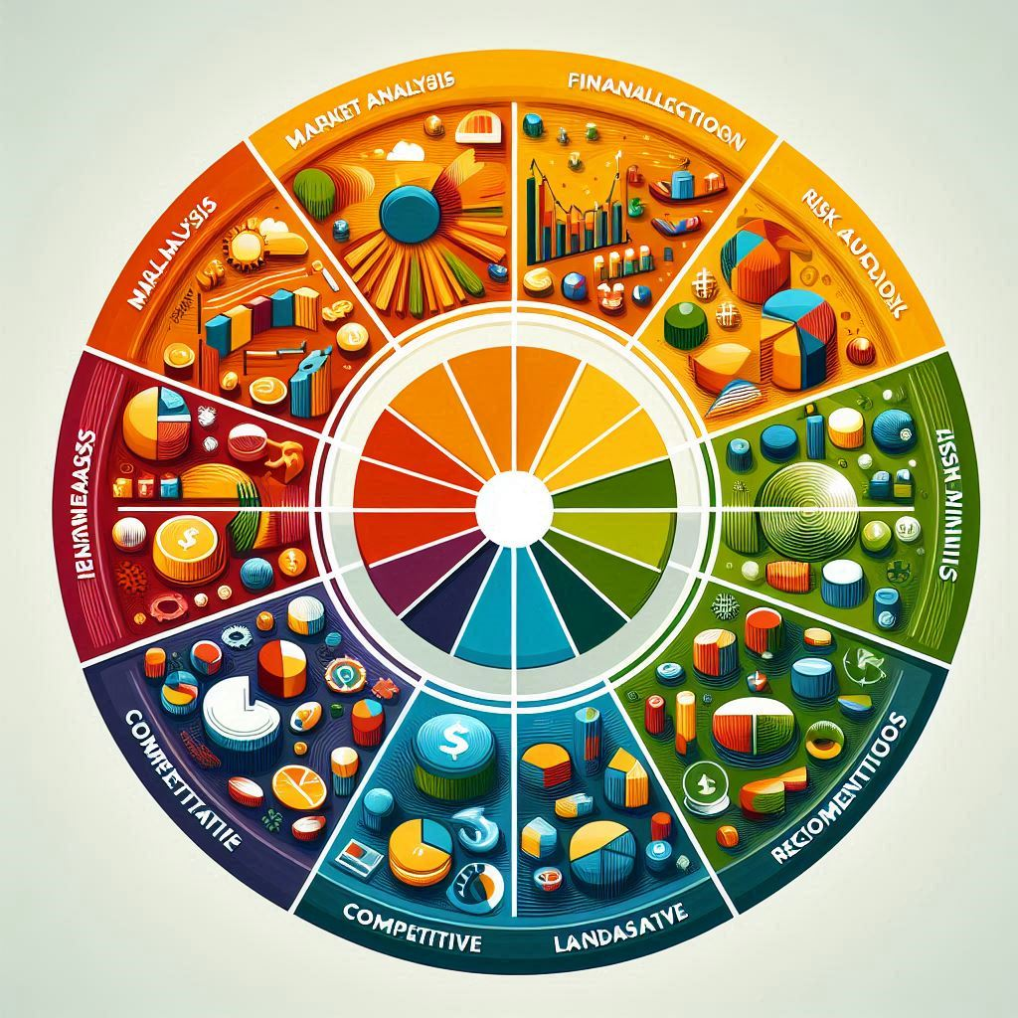
Components of a Business Case
Introduction
Executive Summary
Background information
Business Objectives
Solutions
Financial Analysis
Impact Analysis
Risk Analysis
Recommendations
Notes:
The content and format of a business case document may vary significantly depending on the industry, scope of the initiative and organizational preferences.
The Components on this slide are: Introduction, Executive Summary, Background Information, Business Objectives, Solutions, Financial Analysis, Impact Analysis, Risk Analysis, and Recommendations.
The one we are briefly considering tonight is Impact Analysis. So What is it? What is Impact Analysis?

Slide 4

Impact Analysis, what is it?
Impact analysis evaluates the potential consequences of changes in a project, system, or process to inform decision-making and preparation.
Impact analysis is crucial for identifying risks, allocating resources, and enhancing customer satisfaction for project success.
Notes:
Adaptation is absolutely vital for business survival, yet, many companies are limited by outdated structures and processes unable to keep pace with technological progress. Businesses need to be open to changes like new technologies, and they must be ready to transform fundamental aspects of the business.
But how do they embrace change while minimizing disruption to their business?
One way is to understand the impact of changes. Impact analysis can help with that.
It is a way to anticipate how changes affect people, organizations, processes, information, and technology.
When you understand the implications of change, and you've taken the first step toward mitigating potential risks and disruptions.
That understanding can also help stakeholders identify barriers to adaptation and devise strategies to overcome those barriers.
Business analysts often use the POPIT model to conduct impact analysis. POPIT is an abbreviation of people, organization, processes, information, and technology.

Slide 5

POPIT Model
People
Organisation
Processes
Information
Technology
Impact Analysis using the POPIT model
When a business embarks on a transformation journey, the POPIT model is a guiding framework for conducting impact analysis. You can use it to ensure that you have taken a holistic approach to the change process and considered other aspects of the business, in addition to the more obvious business processes and IT systems. In so doing, you can uncover where problems lie and what improvements might be possible.
The POPIT does not resolve issues, it merely gives you a good basis for making decisions on the future way of working here. As such, it should be reviewed as the project evolves to ensure that any proposals take into consideration all aspects of the organisation. It may be particularly useful to use the POPIT model as a framework for gap analysis.
Notes:
During a change transition, the five key dimensions are used to align stakeholders and assess the impact of change. The POPIT model provides a structured framework for organizing and analyzing information, making it easier to identify potential risks, opportunities, and dependencies.

Slide 6
Steps in Impact Analysis- POPIT Technique
Step 1: Impact on People (Analyse the impact of the proposed change on the people: employees and managers.
Step 2: Impact on the organisation (This is where you analyse the impact of the change on the organisation.
Step 3: Impact on the Processes: (What is the impact on the existing processes in the organisation)
Step 4: Impact on Information: (Analyse the impact on the information within the organisation)
Step 5: Impact on Technology

Slide 7
Scenario:
Jaytech is a leading technology company based in Silicon Valley, specializing in smart home devices. The company has long been at the forefront of technological advancement, with a history of innovation and a strong market presence. Despite having a solid product portfolio, the company has been experiencing a decline in sales due to a lack of follow-up on customer inquiries by its sales agents. Many potential customers express interest in the products but have not received timely responses or follow-up communication, leading to lost sales opportunities.
Jaytech’s leadership team has proposed changes to revitalize and position the company for future success
The changes include:
Reorganization of their traditional, hierarchical structure: The company intends to get rid of traditional departmental silos and encourage cross-functional collaboration by moving to a matrix-type organization with two chains of command instead of one – one on a functional level and the second on the project level. Leadership changes may also be in the pipeline.
Implementation of Customer Relationship Management (CRM) software to streamline lead management, automate follow-up processes, and improve communication with potential customers.
Your task is to conduct an impact analysis using the POPIT model to assess the potential effects of the proposed changes on Jaytech's operations, employees, customers, and overall business performance.
Notes:
So this is the scenario, remember the steps in Impact Analysis.
When you think about the first P, that Impact on People. What sort of questions would you need answers?
Read the scenario section of this activity and consider the proposed changes' impact on people: employees and managers. Remember that an impact can be both positive and negative. Consider questions such as:
Would they be excited by the proposed changes or threatened by them?
Will the proposed initiatives directly affect the individual’s daily tasks and responsibilities?
Would the employees have sufficient training and support to cope with these changes?
What problems could emerge – language, cultural differences, time zones?
Could job satisfaction and employee morale be impacted by the changes?
Okay, lets look at another one, Impact on the Organisation.
What sort of questions will you be looking to answer?
Here are some questions to get you started:
How will the proposed initiatives align with the strategic goals of the organization?
What financial impact will the initiatives have on the organization?
Will the initiatives save money, cost money, or generate revenue?
How will the initiatives affect the workflows and interdepartmental collaboration?
How will the initiatives impact the overall organizational culture, including communication, decision-making, and adaptation to change?
How will the organization's values be impacted?

Slide 8
Impact Analysis - using the POPIT framework
1. PEOPLE
Employees: The reorganization may lead to changes in reporting lines and job roles, potentially causing uncertainty and resistance among employees. Training and support will be critical to ensure a smooth transition.
Leadership: Changes in leadership may affect the company's direction and culture. Clear communication and alignment with strategic objectives will be crucial to maintain employee morale and engagement.
2. ORGANIZATION
Structure: Moving to a matrix organization may foster greater collaboration and flexibility, breaking down silos and improving communication across departments. However, it may also introduce complexity and require careful management to ensure clarity of roles and responsibilities.
Culture: Shifting from a hierarchical to a matrix structure may challenge traditional organizational norms and power dynamics. Leadership will need to actively promote a culture of collaboration, innovation, and adaptability to facilitate the transition.
Notes:
These are some possible answers to the posed questions. They may vary a little or a lot from the answers you’ve given in the POPIT template. An exact match with the example answers is not required since the purpose of this activity is for you to experience the steps that are required to complete impact analysis using the POPIT Model.

Slide 9
3. PROCESSES
Lead Management: Implementing CRM software can streamline lead management processes, improving efficiency and responsiveness to customer inquiries. Automation of follow-up processes can ensure timely communication and enhance customer satisfaction.
Communication: Clear communication channels and protocols will be essential to ensure effective collaboration and coordination across functional and project teams within the matrix structure. Regular feedback mechanisms will help identify and address any bottlenecks or issues.
4. INFORMATION
Data Management: The CRM system will centralize customer data, providing insights into customer preferences, behavior, and interactions.
This enhances the accuracy and completeness of customer information, leading to more effective decision-making and targeted marketing strategies. Implementing CRM may require data migration from legacy systems, which could result in data inconsistencies or loss if not managed properly. Additionally, ensuring data integrity and maintaining a single source of truth across the organization might pose challenges during implementation.
Security: CRM systems typically offer robust security features enhancing data security and compliance with regulations. Centralized data storage also simplifies security management and monitoring. However, integrating CRM with existing systems and databases may introduce vulnerabilities if not properly configured or secured.

Slide 10
Questions to consider for each step
2. Please reflect on the second dimension of the POPIT model: the organization. This is where you analyse the impact of the proposed changes on the organization. Here are some questions to get you started:
How will the proposed initiatives align with the strategic goals of the organization?
What financial impact will the initiatives have on the organization?
Will the initiatives save money, cost money, or generate revenue?
How will the initiatives affect the workflows and interdepartmental collaboration?
How will the initiatives impact the overall organizational culture, including communication, decision-making, and adaptation to change?
How will the organization's values be impacted?
3. Reflect on the proposed initiatives and imagine their impact on the organization's existing processes. Consider the following questions:
Are they likely to disrupt the existing processes or enhance them?
Will the processes need to be re-designed or just optimized?
Will the processes be more efficient? More effective? Will new processes need to be created?
What measures need to be taken to ensure smooth integration of the initiatives with the existing processes and systems? For example: financial systems, management information systems, customer support?
1. The first step of POPIT is to analyse the impact of the proposed changes on people.
Consider the proposed changes' impact on people: employees and managers. Remember that an impact can be both positive and negative. Consider questions such as:
Would they be excited by the proposed changes or threatened by them?
Will the proposed initiatives directly affect the individual’s daily tasks and responsibilities?
Would the employees have sufficient training and support to cope with these changes?
What problems could emerge – language, cultural differences, time zones?
Could job satisfaction and employee morale be impacted by the changes?
4. The next step is to analyse the impact of the proposed initiatives on the information within the organization. Consider questions such as:
How will the initiatives impact data storage, management, and archiving processes, particularly regarding scalability and long-term usability? How will the proposed initiatives affect the accessibility, accuracy, and timeliness of critical information within the organization?
What changes will the initiatives bring to the organization's data security, privacy compliance, and information governance practices?
What key performance indicators (KPIs) should be monitored to evaluate the initiatives' effectiveness and impact on information management and utilization?
5. To analyse the impact of the proposed changes on technology you’ll now reflect on the proposed initiatives and their impact on the last dimension of the POPIT model: Technology.
How will the proposed initiatives impact the organization's technological infrastructure, including hardware, software, and networking components?
What changes will the initiatives bring to user experience, interface design, and accessibility of technology solutions and platforms?
How will the initiatives affect the organization's technological capabilities, including data processing, analytics, automation, and innovation?
What are the security and risk implications of the initiatives on technology, and what measures must be taken to mitigate potential vulnerabilities or threats?

Slide 11
Key Take Away:
By analysing the impact of the proposed changes using the POPIT model, the organization can develop a more informed approach to managing the transitions related to organizational restructuring, Agile adoption, and digital transformation. This analysis enables the organization to anticipate and address potential challenges while leveraging the opportunities that arise from these changes.

Slide 12


